Slide 1
Reproducing „A Note on Averaging Day-Ahead Electricity Price Forecasts Across Calibration Windows”
Iga Moskwa,
Wojciech Warzecha

Slide 2

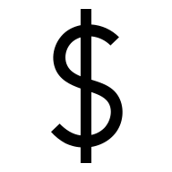


A Note on Averaging Day-Ahead Electricity Price Forecasts Across Calibration Windows
Why we choose this paper?
Model that we know ARX
Simple idea but clever
Data that we know – GEFCom2014

Slide 3
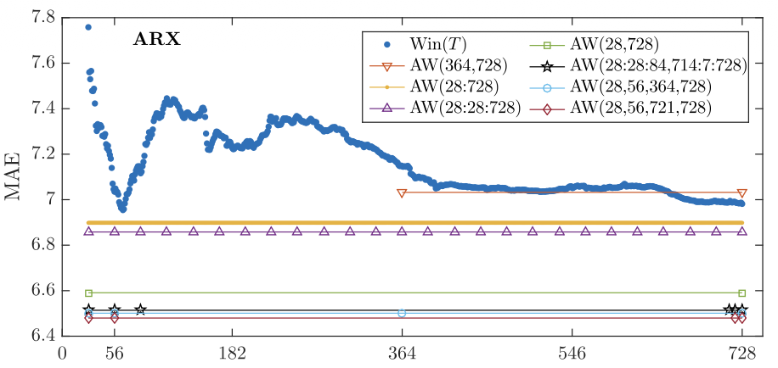
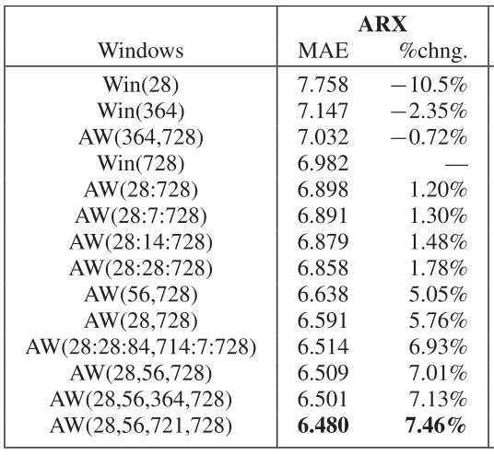
A Note on Averaging Day-Ahead Electricity Price Forecasts Across Calibration Windows
How did the authors search for the best T, and what did they find?
ARX model:
TABLE 1. MEAN ABSOLUTE ERRORS (MAE) FOR SELECTED CALIBRATION WINDOW SETS AND THE ARX (IN DESCENDING ORDER) MODEL. RELATIVE CHANGES (%CHNG.) WITH RESPECT TO THE WIN(728) MAE WITHIN EACH MODEL CLASS ARE ALSO REPORTED ARX
Fig 1. Mean Absolute Errors (MAE) as a function of the window length T = 28, . . . , 728 (blue circles) and obtained by averaging forecasts across calibration windows (lines with symbols representing window lengths) for the
ARX

Slide 4
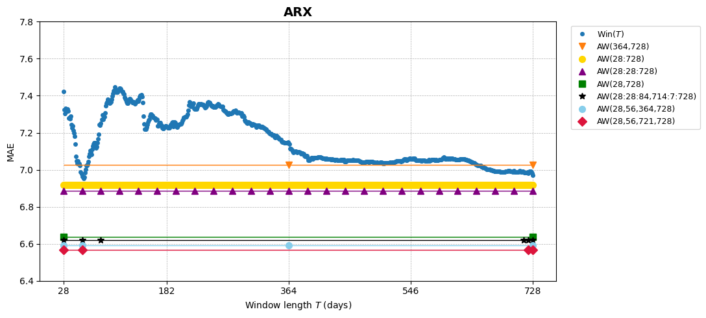
A Note on Averaging Day-Ahead Electricity Price Forecasts Across Calibration Windows
Comparison of results

Slide 5
A Note on Averaging Day-Ahead Electricity Price Forecasts Across Calibration Windows
Comarison of results
ARX
Windows | MAE | % change
Win(28) | 7.423 | −6.09 %
Win(364) | 7.143 | −2.41 %
AW(364,728) | 7.025 | −0.77 %
Win(728) | 6.971 | 0.00 %
AW(28:728) | 6.916 | 0.79 %
AW(28:7:728) | 6.910 | 0.88 %
AW(28:14:728) | 6.902 | 0.99 %
AW(28:28:728) | 6.888 | 1.21 %
AW(56,728) | 6.651 | 4.81 %
AW(28,728) | 6.637 | 5.02 %
AW(28:28:84,714:7:728) | 6.618 | 5.33 %
AW(28,56,364,728) | 6.593 | 5.72 %
AW(28,56,728) | 6.584 | 5.88 %
AW(28,56,721,728) | 6.566 | 6.16 %

Slide 6
Progress summary
Data collected and preprocessed (GEFCom2014)
Full ARX model from the article implemented
Rolling windows of 28–728 days reproduced
Win(T) and all AW(T) sets computed
Plots obtained closely match Fig. 1–2 from the article
Main research findings successfully confirmed
Comparison materials and documentation prepared

Slide 7
Thank you for your attention.

